Slide 1
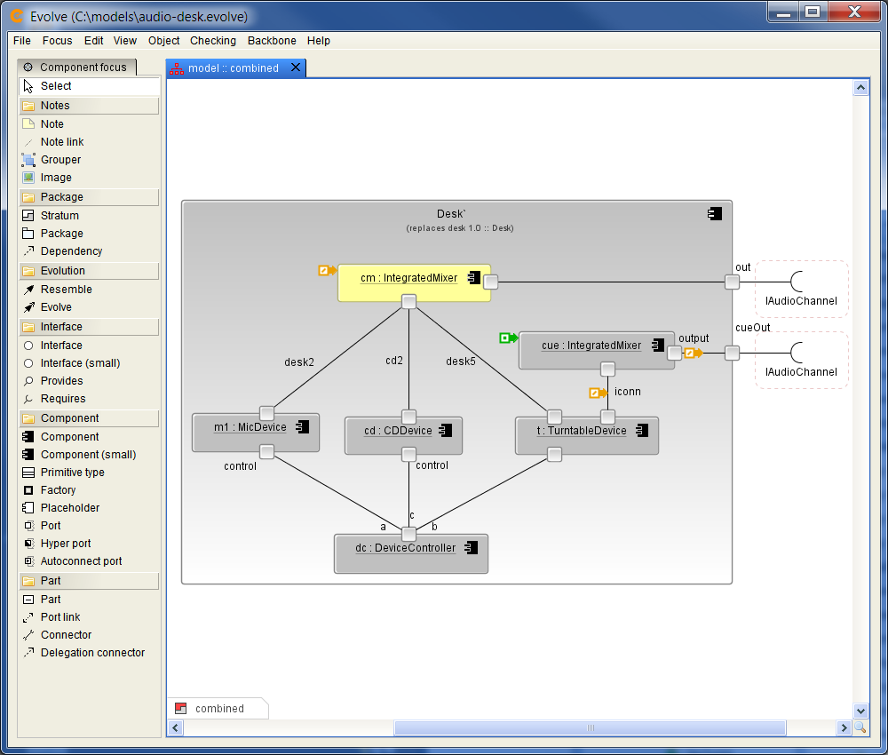
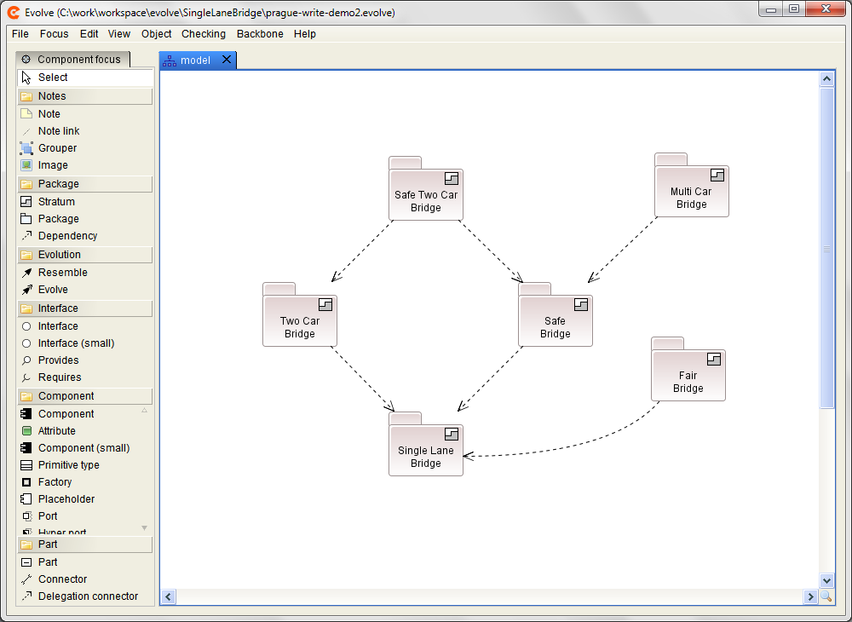
Evolve: Tool Support for Architecture Evolution
Andrew McVeigh, Jeff Magee, Jeff Kramer Imperial College, London

Slide 2
Extensibility Requirements...
ALTER Must allow any possible extension even if unplanned
NO_IMPACT Others should not be impacted by extensions they don’t want
COMBINE Extensions / upgrades can be combined, problems rectified
DECENTRALIZED Support a fully decentralized environment with many parties
NO_SOURCE Must work even without source code!
Notes:
Show slide on other projector of decentralized team environment.
ALTER – commensurate pushed us in the direction of hierarchical components which support multiple levels of abstraction.
NO_IMPACT means we can’t directly amend the base architecture for a new requirement.
These requirements basically pushed us directly into providing full evolution support from an architectural perspective, with many characteristics of a distributed CM system like Mercurial.
Decentralized: no common CM system, lots of ways of distributing system.

Slide 3
The Evolve Approach
Add 3 concepts to a Darwin/ROOM-like ADL
A
B
1. Resemblance:
Reuse via deltas
A
B
2. Replacement:
Global substitution (replacement +
resemblance = evolution)
3. Stratum:
Groups definitions
base
extension
Notes:
Talk through original motivation for work

Slide 4
Summary
Evolution is intrinsic to the ADL
Allows us to integrate evolution and design concepts
Supports evolution with no central design authority
Complementary with existing CM systems
Supports import of existing Java components / beans
Implementation mappings subject to evolution also
Allows a more agile approach to architecture
Variance / extension points not needed in advance
Design for current requirements
http://www.intrinsarc.com
Notes:
- version control can be treated orthogonally (2 axes): time based evolution and system variation: pragmatic
-

